Slide 1


The Haptic Glove Development Project
Levi Graham and Riley Nichols

Slide 2
Slide Overview
The team
Project Summary
Parts
The Process
Sprints 1-2
Sprints 3-5
Sprints 6-8
Sprints 9-11
Issues Encountered
Future Improvements
Demo
Photos
Questions

Slide 3
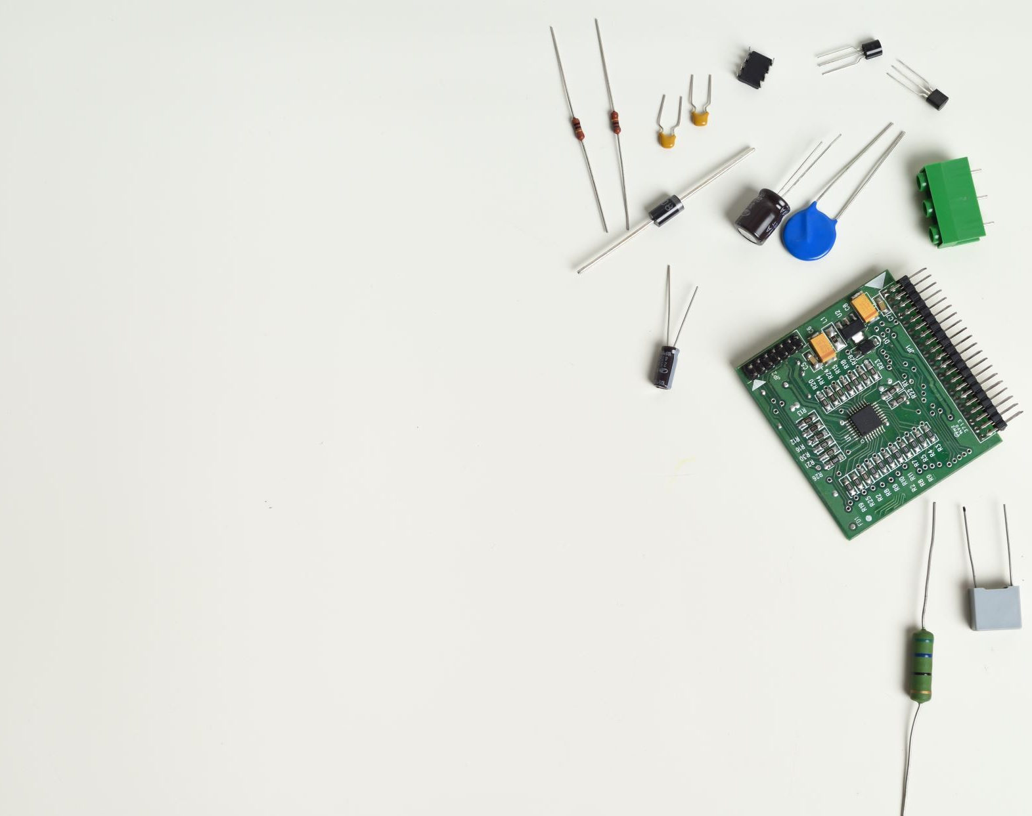
The Team
Levi Graham
Scrum Coach
Technical Lead (Software)
Riley Nichols
Technical Product Manager
Technical Lead (Hardware)

Slide 4
The Project
Develop a haptic glove to use as usable input on a computer.
Design the glove to be thinner and lighter than others, and to be wireless.
Build the glove using off the shelf parts.
Provide instructions to anyone who would like to build a haptic glove of their own.

Slide 5
Parts
Part Name | Quantity
Arduino R3 Uno | 1
Long Flex Sensors | 4
Short Flex Sensors | 1
IMU (Inertail Measurment Unit) | 1
Multiplexer | 1
Bluetooth Module (HC-06) | 1
22-Gauge Wire | Enough
PCB (Printable Circuit Board) | 1
*This does not include non-electronic parts and materials such as the glove itself or the materials needed to attach this to a glove.

Slide 6
The Process (Sprints 1-2)
The first two sprints was research focused.
Sprint 1 was part research and ordering.
Sprint 2 was program research and testing.
A lot of the parts and programs we initially thought we would stick with fell through, such as a replacement for the flex sensors, the Arduino, and Unity.

Slide 7
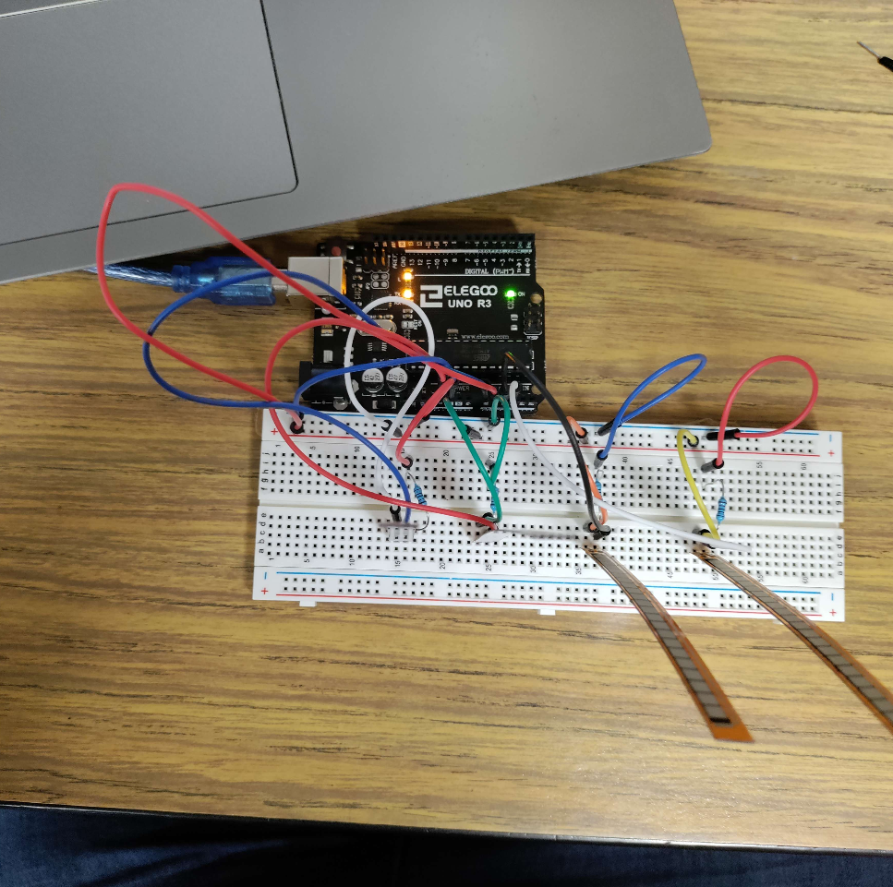
The Process (Sprints 3-5)
Sprints 3-5 were testing and understanding each of the individual parts and sensors.
Sprint 3 focused on testing each sensor and making sure it worked independently.
Sprint 4 looked at combining the sensors together into a single working circuit.
Sprint 5 wrapped up Sprint 4 and looked at improving the response time between the Arduino and the computer.

Slide 8
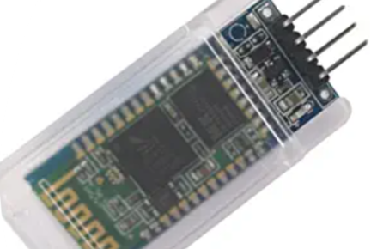
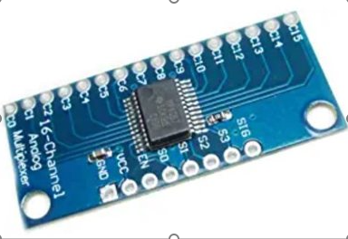
The Process (Sprints 6-8)
Sprint 6-8 was primarily about Bluetooth connectivity.
Ended up working on Bluetooth connectivity over the course of all three sprints.
Implemented multiplexer to allow for all five flex sensors.

Slide 9
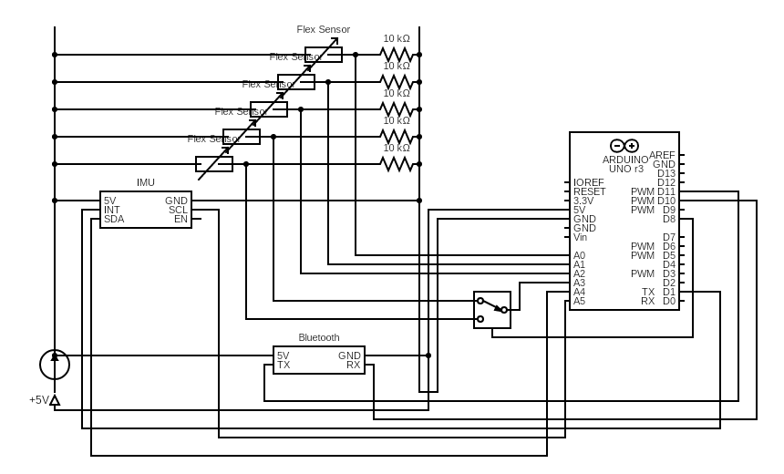
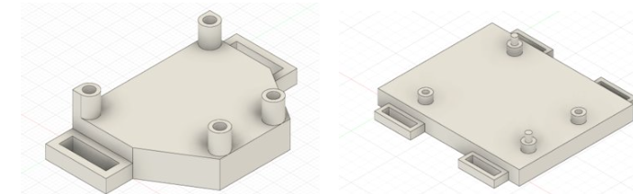
The Process (Sprint 9-11)
These last three sprints involved the soldering of the completed circuit design.
Sprint 9 primarily involved the drawing of the circuit design, the ordering of the PCB board, and the building of the 3D printed parts.
The last 2 sprints involved the actual soldering of the circuit and testing the readings to ensure accurate wireless communication.

Slide 10

Issues of the Project/Lessons Learned
Working with Bluetooth
Parts Selection
More sensors than original controller supported
Glove software driver development

Slide 11
Future Improvements
Design glove driver that works with the computer at the OS level.
Improve the design of the glove for more comfort.
Simplify glove design and expand functionality

Slide 12
Demo
Demo Video Link on Vimeo

Slide 13

Questions?

